Slide 1
Week 6 – The 1st law
$$dU=dq+dw$$
This is the same $U(T,V)$ that we’ve been talking about
If $dq+dw$ is positive, the energy of the system goes up
If $dq+dw$ is negative, the energy of the system goes down
If changes are large, we say $∆U=q+w$
$$U(T,V)$$
V
T

Slide 2


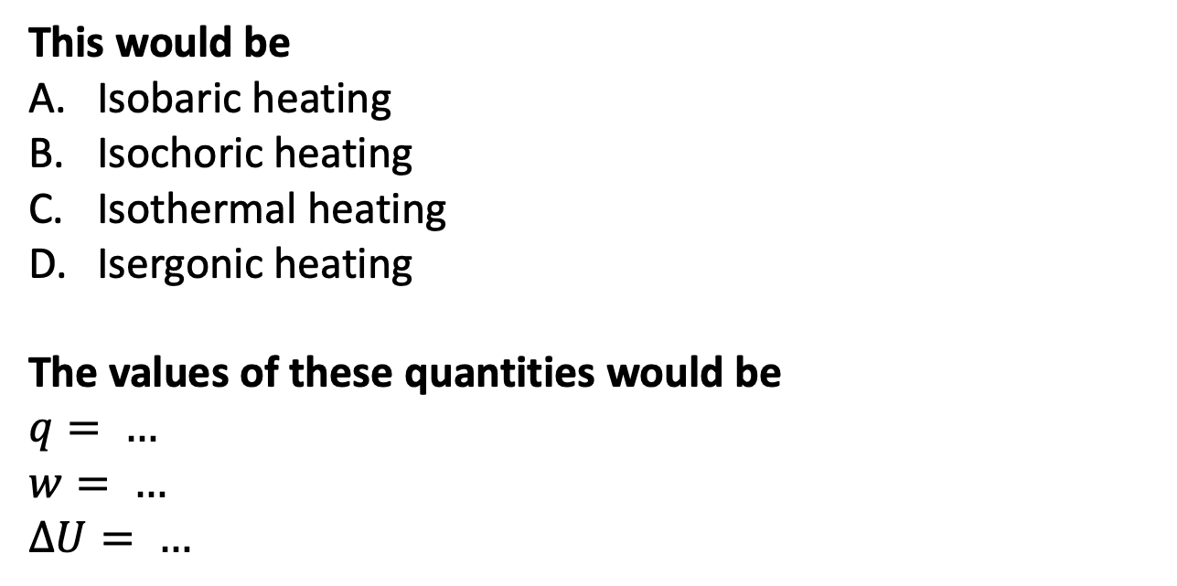
The kind of question I might ask – Applying the 1st Law
$T_{surr}>T$
$50 J$ of heat go in,
keeping the volume fixed
$$U(T,V)$$
$$T_{surr}$$
V
This would be
Isobaric heating
Isochoric heating
Isothermal heating
Isergonic heating
The values of these quantities would be
$$q= …$$
$w= …$
$∆U= …$
T
T
(system)

Slide 3
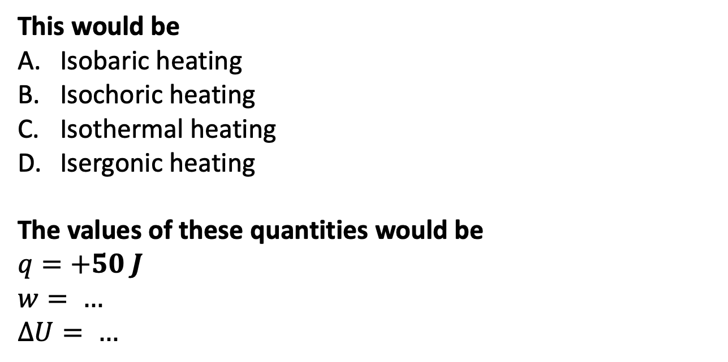
The kind of question I might ask – Applying the 1st Law
$T_{surr}>T$
$50 J$ of heat go in,
keeping the volume fixed
$$U(T,V)$$
$$T_{surr}$$
V
This would be
Isobaric heating
Isochoric heating
Isothermal heating
Isergonic heating
The values of these quantities would be
$$q=+50 J$$
$w= …$
$∆U= …$
T
T
(system)

Slide 4
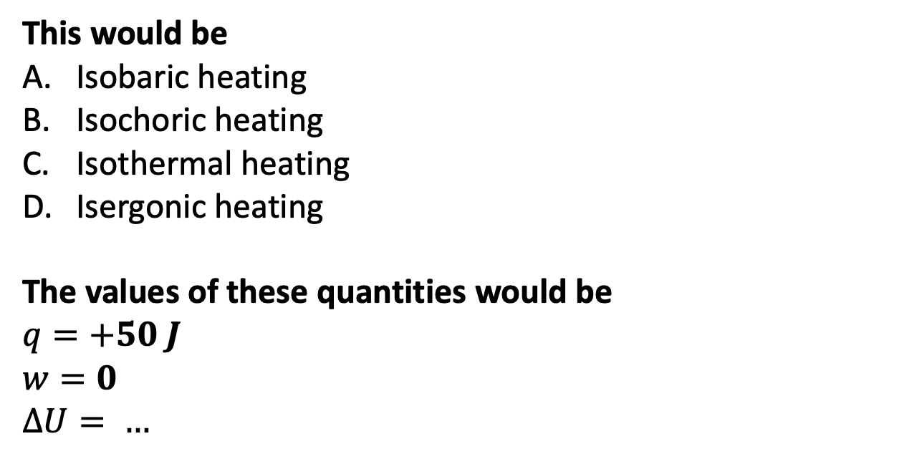
The kind of question I might ask – Applying the 1st Law
$T_{surr}>T$
$50 J$ of heat go in,
keeping the volume fixed
$$U(T,V)$$
$$T_{surr}$$
V
This would be
Isobaric heating
Isochoric heating
Isothermal heating
Isergonic heating
The values of these quantities would be
$$q=+50 J$$
$w=0$
$∆U= …$
T
T
(system)

Slide 5
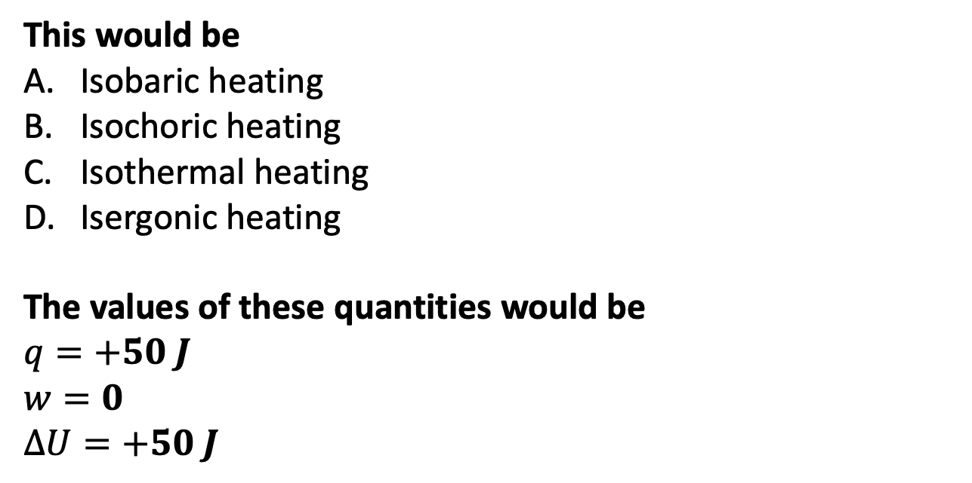
The kind of question I might ask – Applying the 1st Law
$T_{surr}>T$
$50 J$ of heat go in,
keeping the volume fixed
$$U(T,V)$$
$$T_{surr}$$
V
This would be
Isobaric heating
Isochoric heating
Isothermal heating
Isergonic heating
The values of these quantities would be
$$q=+50 J$$
$w=0$
$∆U=+50 J$
T
T
(system)

Slide 6
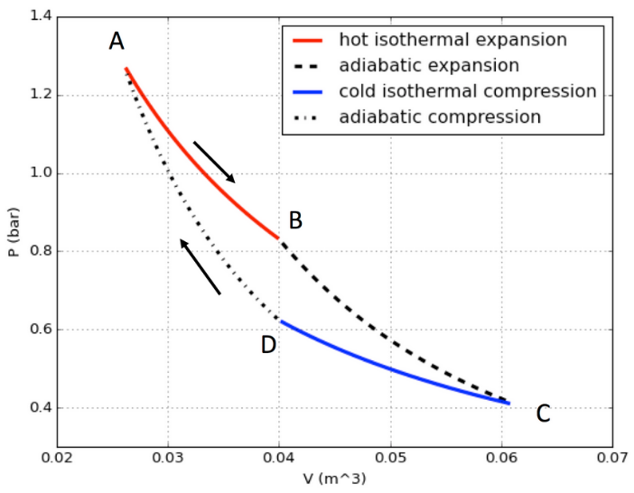
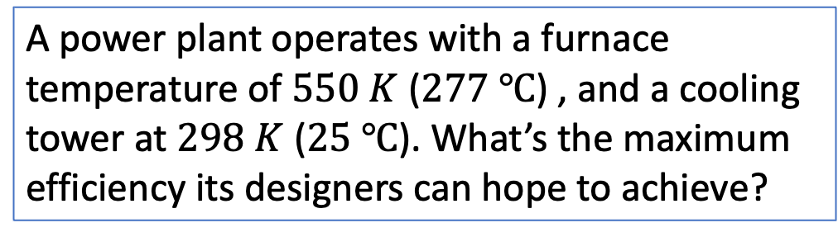




The kind of question I might ask – Maximum efficiency of a Carnot engine
$$q_{1}$$
A power plant operates with a furnace temperature of $550 K$ ($277 ℃$) , and a cooling tower at $298 K$ ($25 ℃$). What’s the maximum efficiency its designers can hope to achieve?
$$q_{4}=0$$
$$q_{2}=0$$
$$q_{3}$$

Slide 7

The kind of question I might ask – Maximum efficiency of a Carnot engine
$$q_{1}$$
A power plant operates with a furnace temperature of $550 K$ ($277 ℃$) , and a cooling tower at $298 K$ ($25 ℃$). What’s the maximum efficiency its designers can hope to achieve?
$$q_{4}=0$$
$$q_{2}=0$$
$$q_{3}$$
$$ε_{max}=∆T/T_{hot}$$

Slide 8
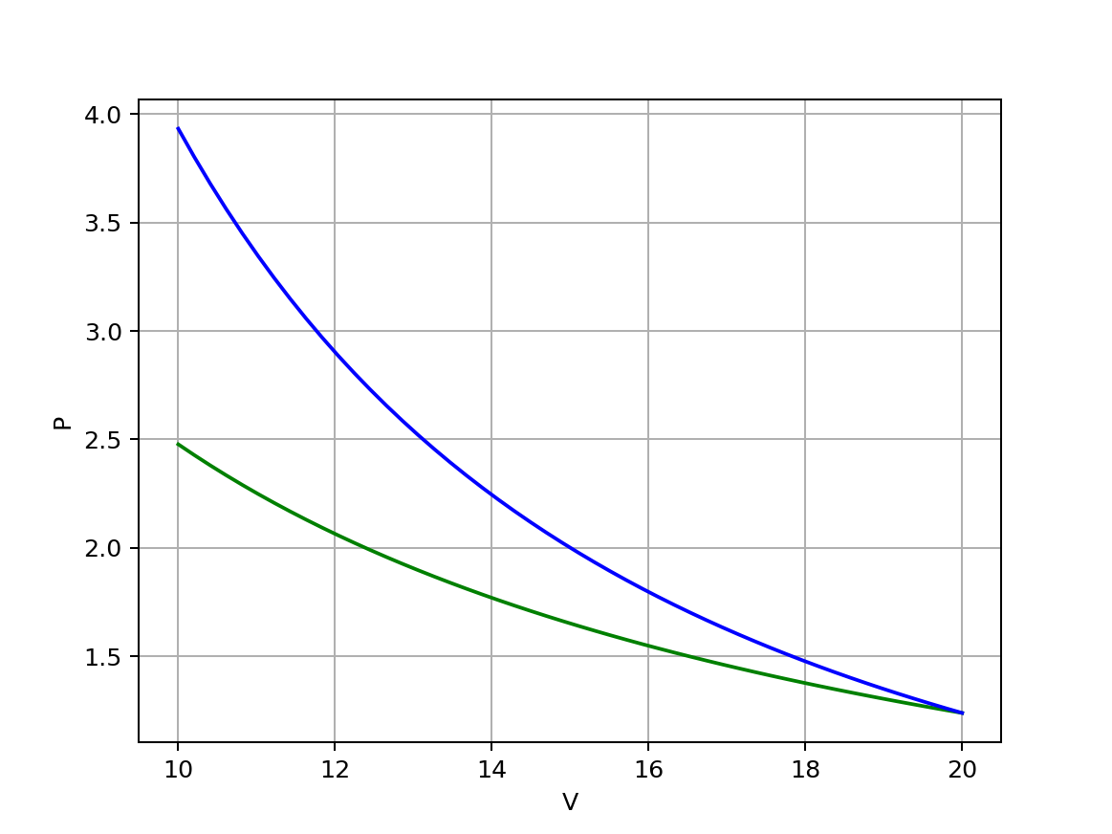
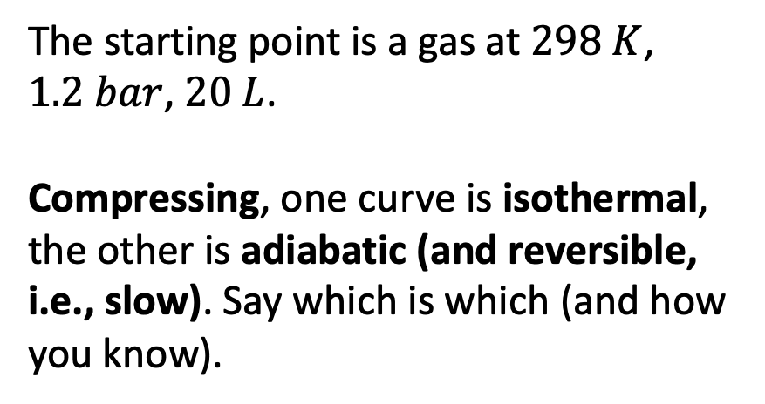
The kind of question I might ask – Isothermal vs adiabatic compression
The starting point is a gas at $298 K$, $1.2 bar$, $20 L$.
Compressing, one curve is isothermal, the other is adiabatic (and reversible, i.e., slow). Say which is which (and how you know).

Slide 9
The kind of question I might ask – Isothermal vs adiabatic compression
The starting point is a gas at $298 K$, $1.2 bar$, $20 L$.
Compressing, one curve is isothermal, the other is adiabatic (and reversible, i.e., slow). Say which is which (and how you know).
Gases heat up when compressed adiabatically and reversibly so the pressure would be higher

